Slide 1
ANALYSIS AND VISUALIZATIONS OF CYBER ATTACKS
BY:- Aditya Padhi
Ashis Pramanik
Tulsi Prasad Mohanty
Biswajit Khandual
Guided By:-
Nirmal Kumar Sahoo

Slide 2
CONTENTS:-
INTRODUCTION
Objective
History
Importance
Software and hardware used
Libraries are used in python
Code

Slide 3
INTRODUCTION:-
Cyber attacks are becoming more common and dangerous in today’s digital world. These attacks can harm a company’s data, systems, and overall operations. To protect against these threats, it is important to study and understand how attacks happen, what types of attacks are used, and how often they occur.
This project focuses on analyzing and visualizing data from cyber attacks to identify patterns and weaknesses in security. By looking closely at this data, we can better understand the risks and help organizations improve their defenses to stay safe from future attacks.

Slide 4
OBJECTIVES:-
The main goals of this project are to collect and study data about cyber attacks to understand how they happen and what types are most common. By analyzing this data, we want to find patterns and trends that can show weaknesses in the system. We will use visual tools to make the data easier to understand. The insights from this work will help organizations improve their cyber security defenses and be better prepared to face future cyber threats.

Slide 5
HISTORY:-
Cyber attacks began when people started using the internet and computers. At first, attacks were easy and did little damage. But as time passed, attackers learned new ways to break into computers and steal information. Today, attacks are more dangerous. Some lock your data and ask for money, some trick you to give passwords, and some come from other countries to cause harm. Because attacks happen a lot, experts collect data to learn about them.
They use special tools to show this data in pictures. This helps companies find problems and keep their information safe. Understanding cyber attacks is very important today.
In 1988, a program called the Morris Worm spread to many computers on the internet. It made them slow and caused problems. This was one of the first big cyber attacks and helped people understand the need for computer security.
In 2000, a virus called ILOVEYOU spread through emails. When people opened the email and clicked the attachment, the virus copied itself and sent to all their friends. It deleted many files and caused problems for computers all over the world.
In 2010, a worm called Stuxnet was found. It attacked machines in factories, especially nuclear plants. It made the machines work wrong without anyone noticing. This attack was very smart and showed that cyber attacks can hurt real machines, not just computers.

Slide 6
IMPORTANCE:-
Cyber attacks are happening more often and can cause big problems. They can steal important data, damage computers, or stop work. By studying and showing the attack data in pictures and charts, we can understand how these attacks happen and where the weak points are. This helps people fix problems faster and protect their systems better. This project is important because it helps keep data and systems safe from future attacks.

Slide 7
SOFTWARE AND HARDWARE USED:-
Hardware
Processor- Intel i3 10 gen
Graphics card- Nvidia gtx 1650 4 Gb Software
Windows 10.
Google colab.

Slide 8
LIBRARIES ARE USED IN PYTHON:-
Pandas.
Numpy.
Matplotlit.
Seaborn.
Plotly.express.

Slide 9
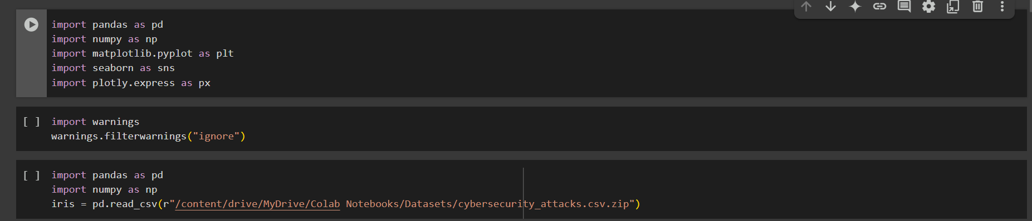
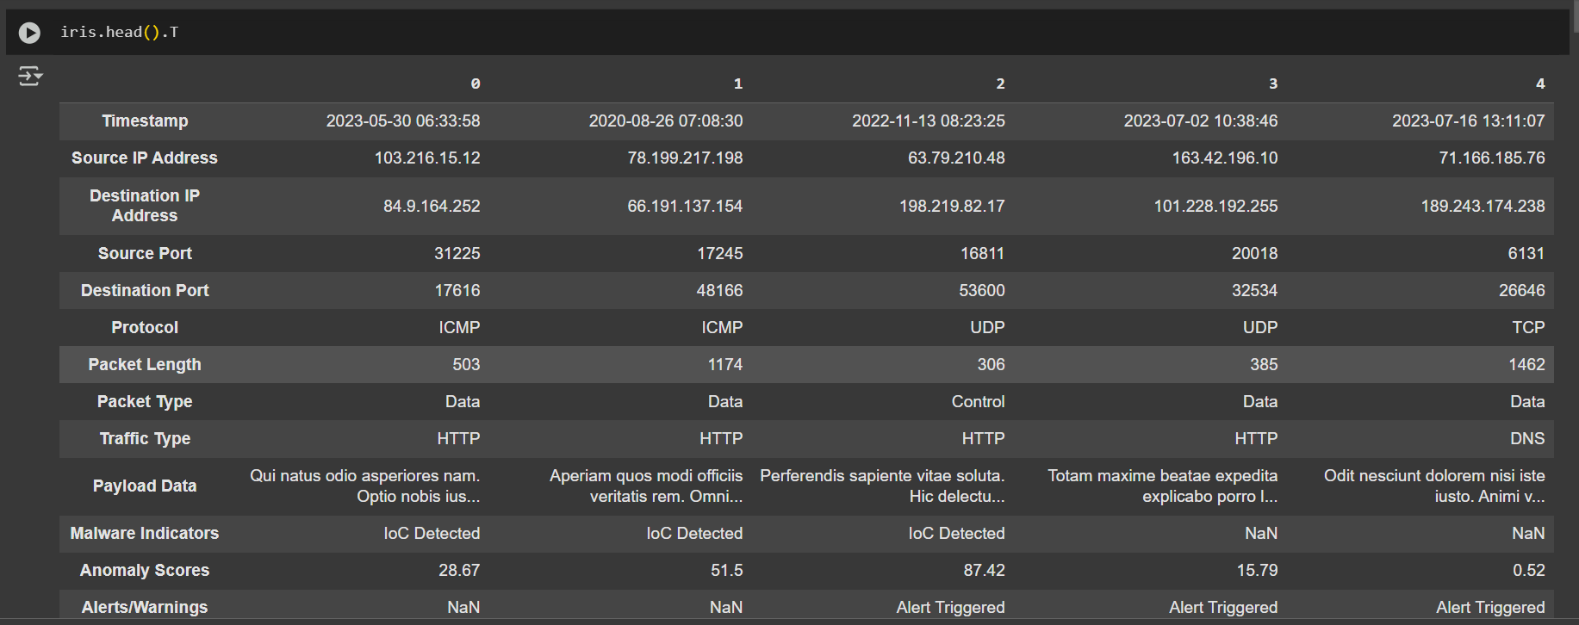
CODES:-

Slide 10
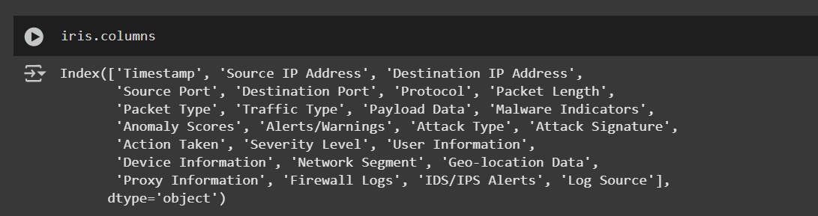
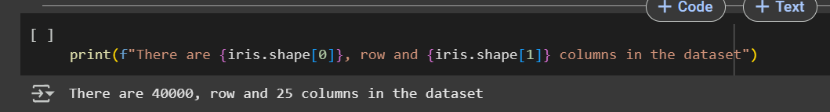
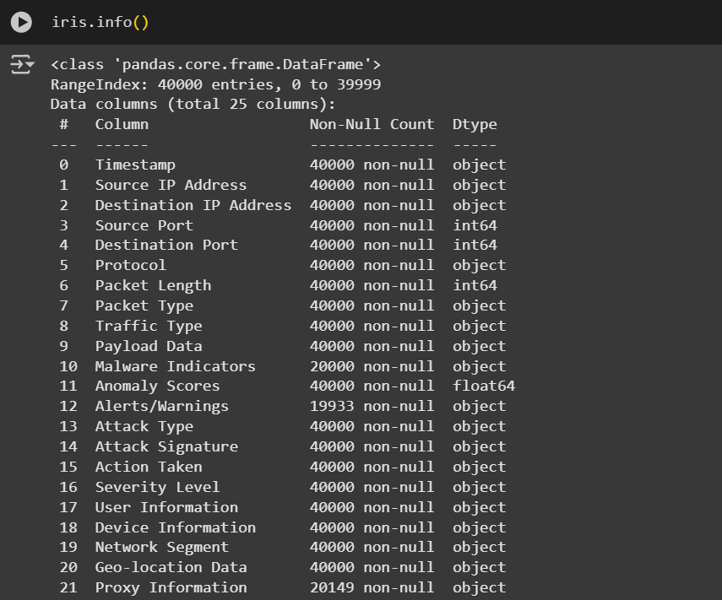
CODES:-

Slide 11
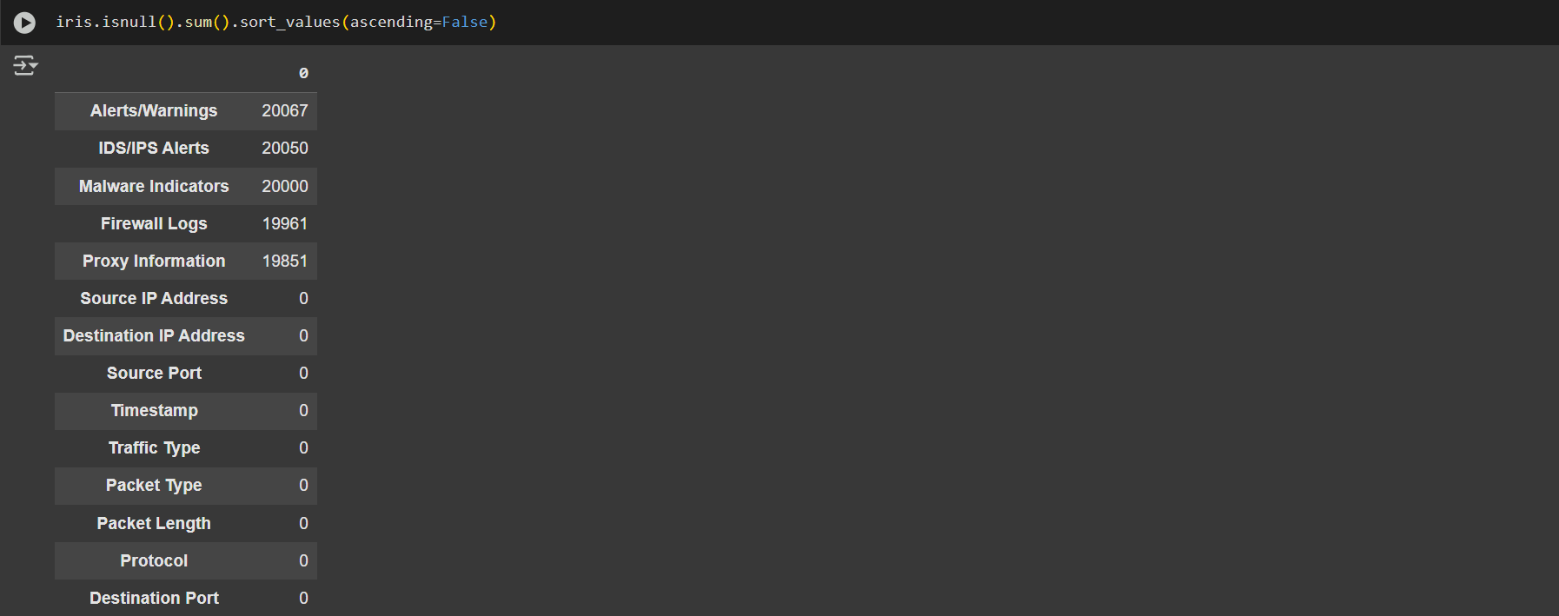
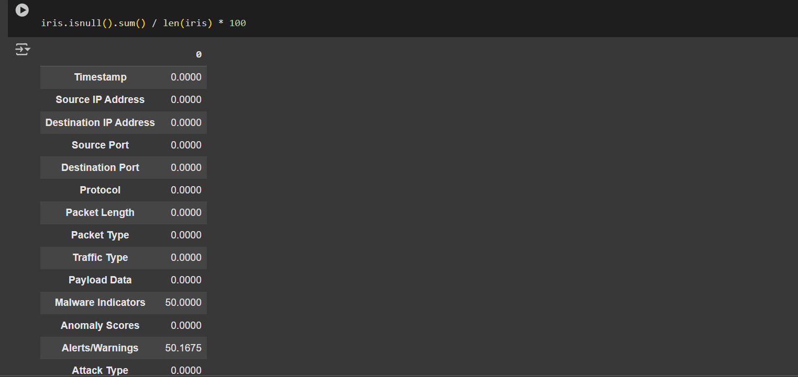
CODES:-

Slide 12
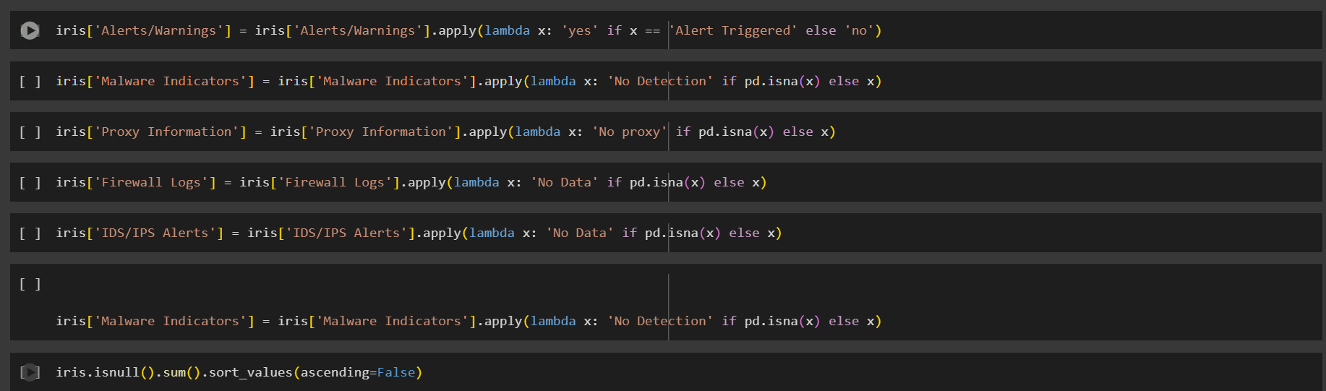
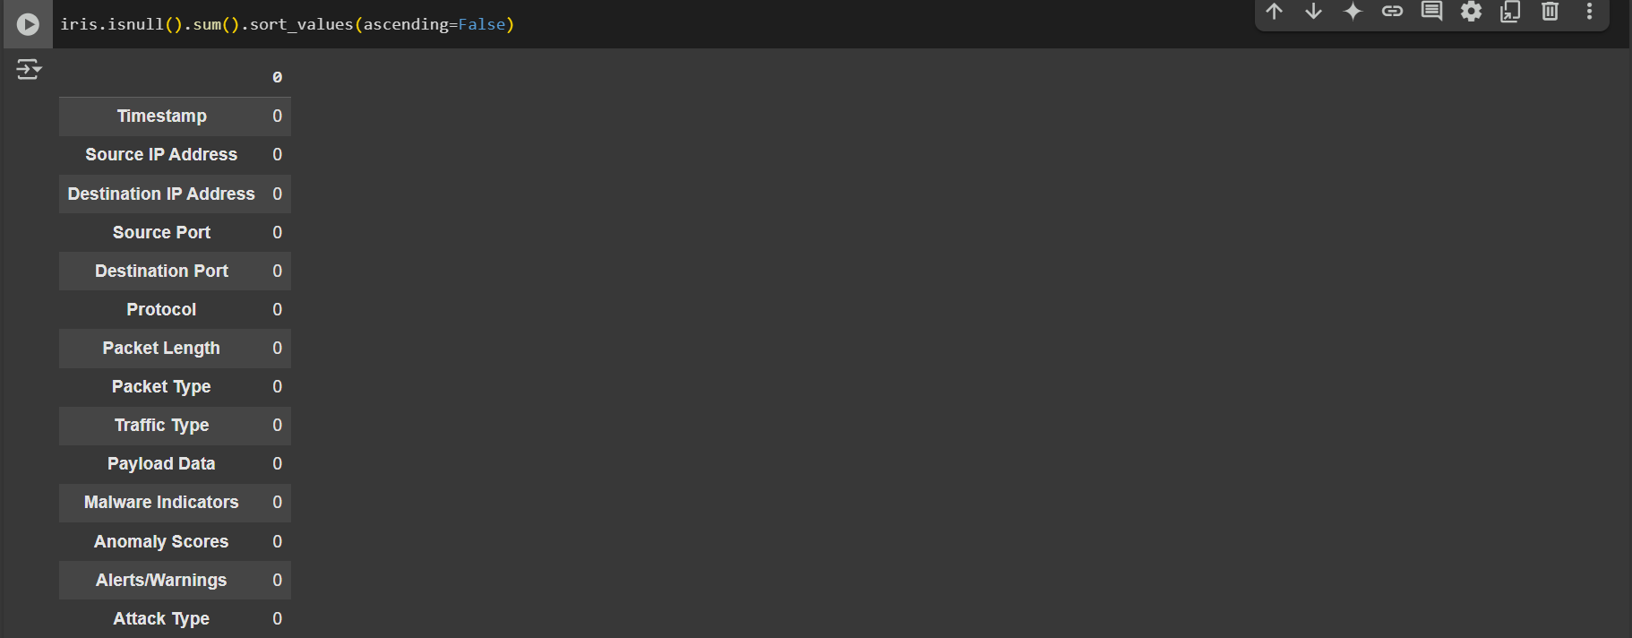
CODES:-

Slide 13
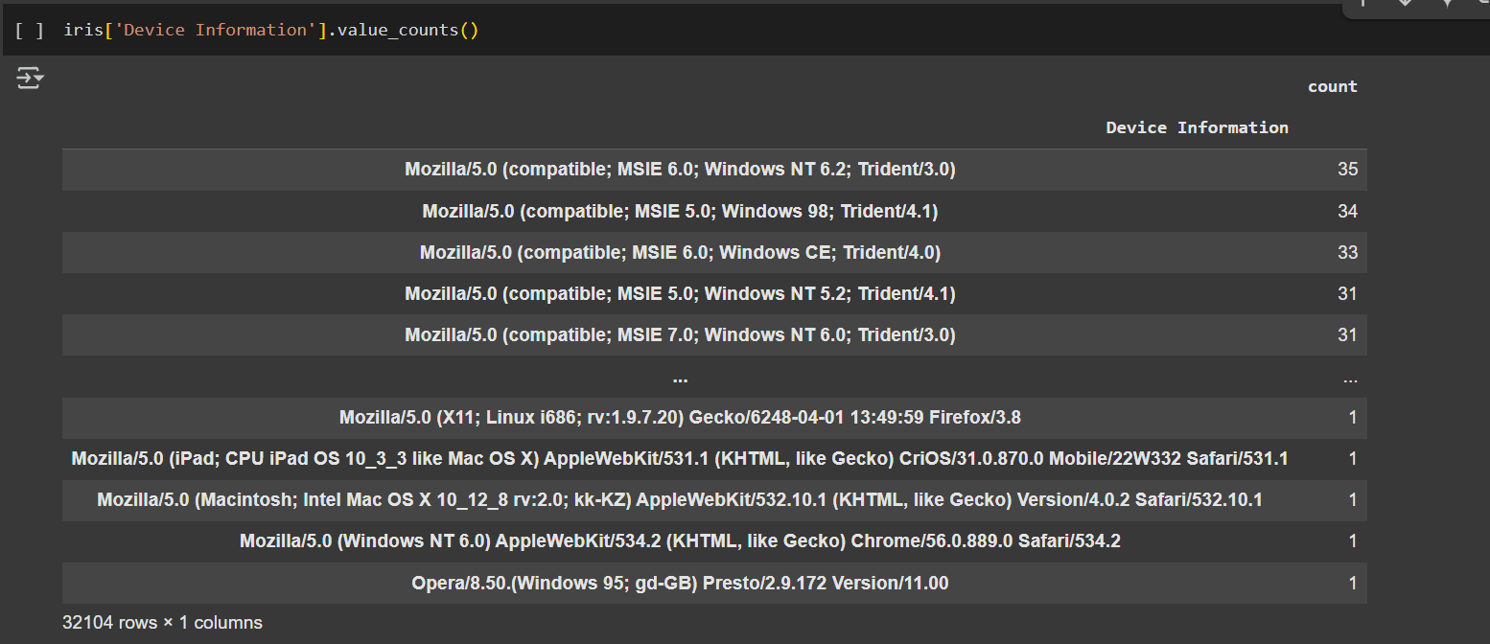
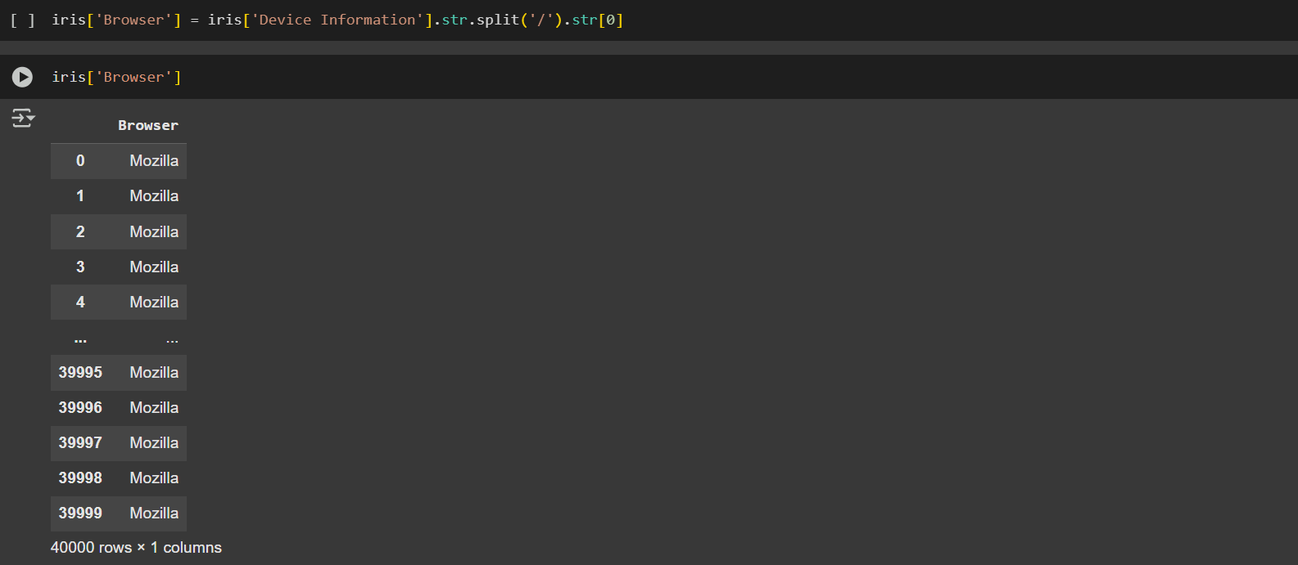
CODE:-

Slide 14
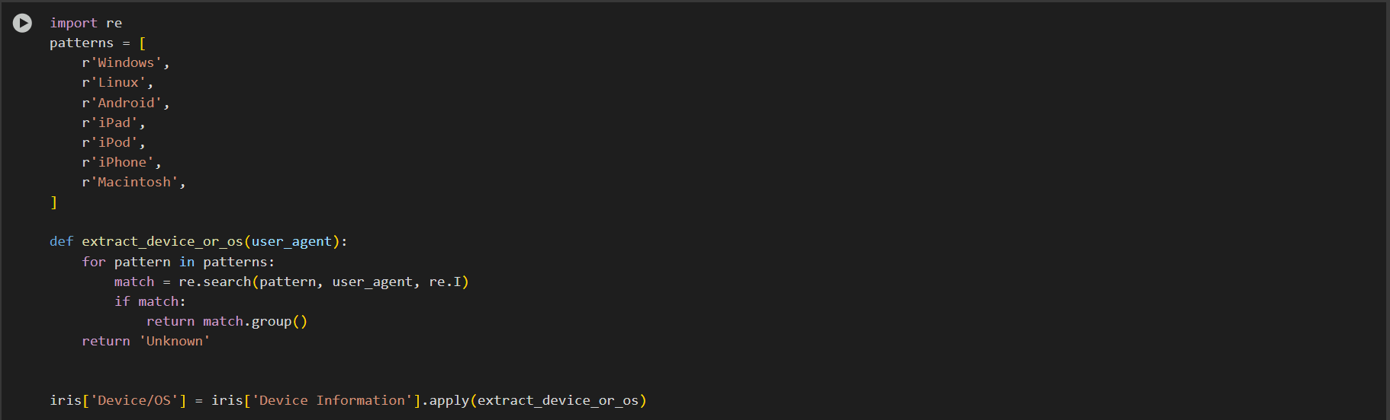
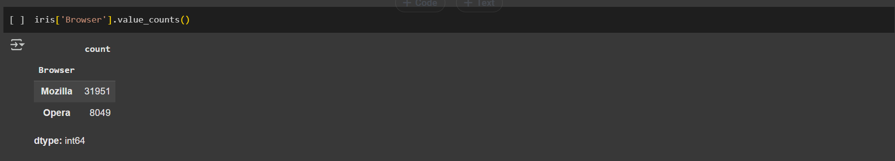
CODE:-

Slide 15
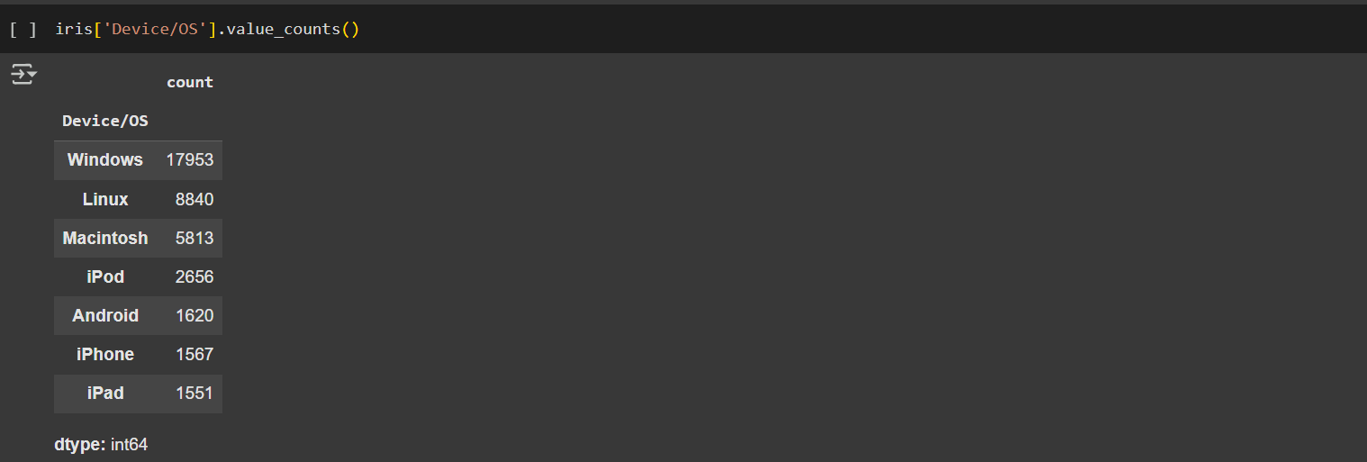
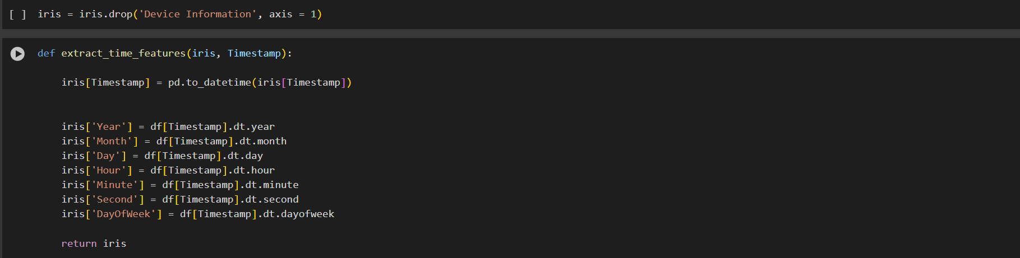
CODE:-

Slide 16
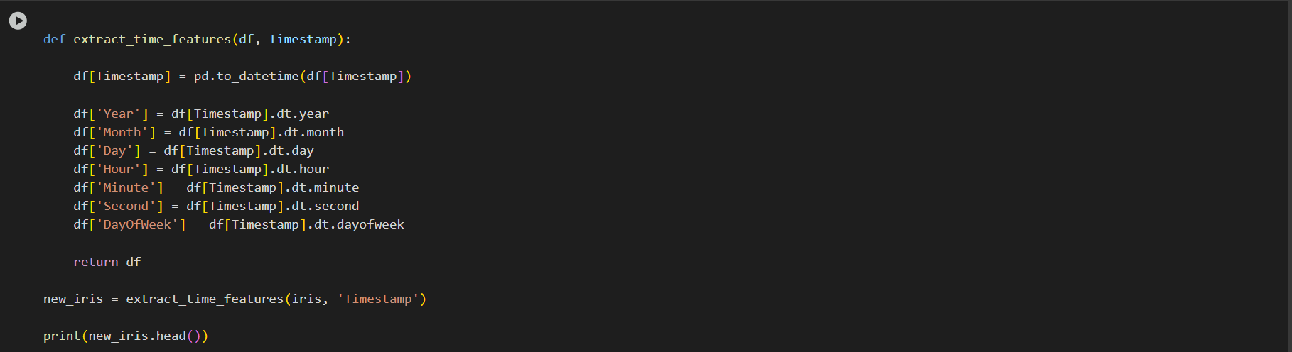
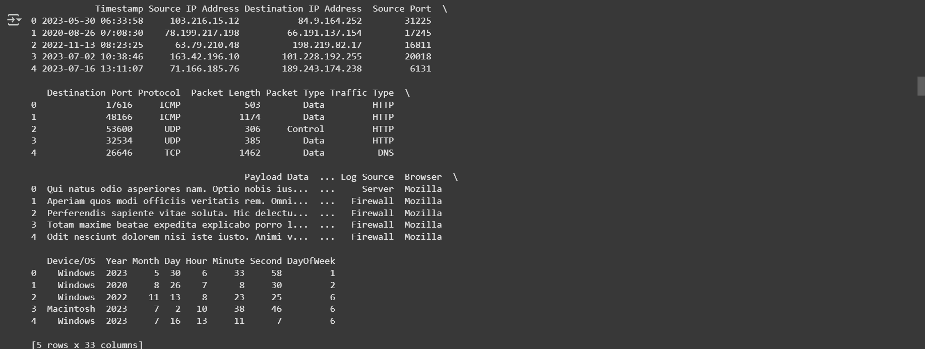
CODE:-

Slide 17
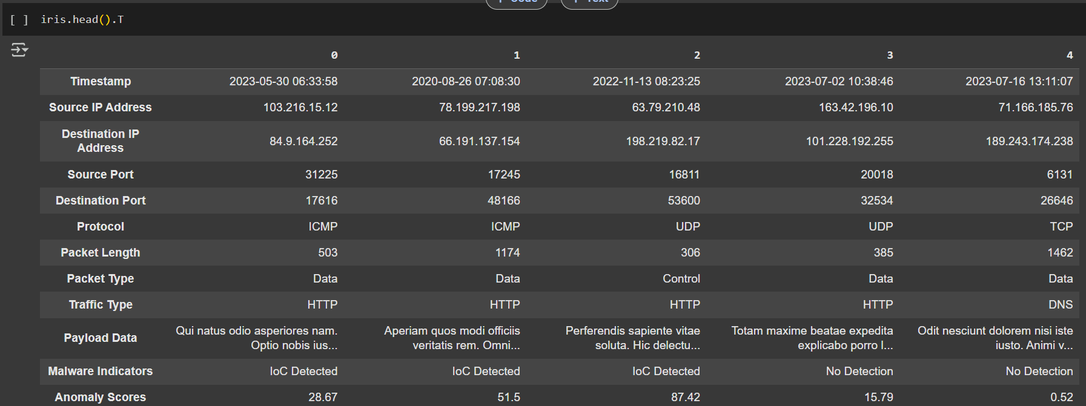
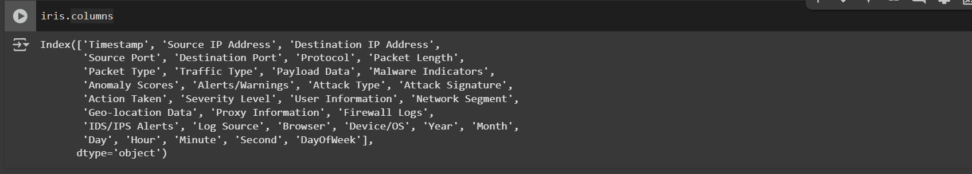
CODE:-

Slide 18
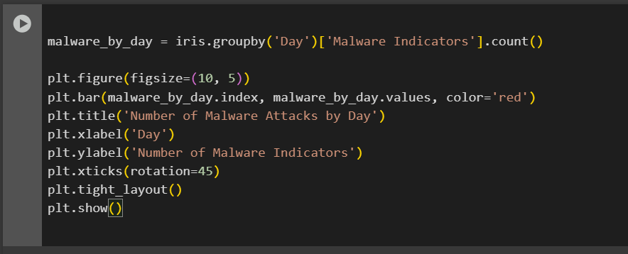
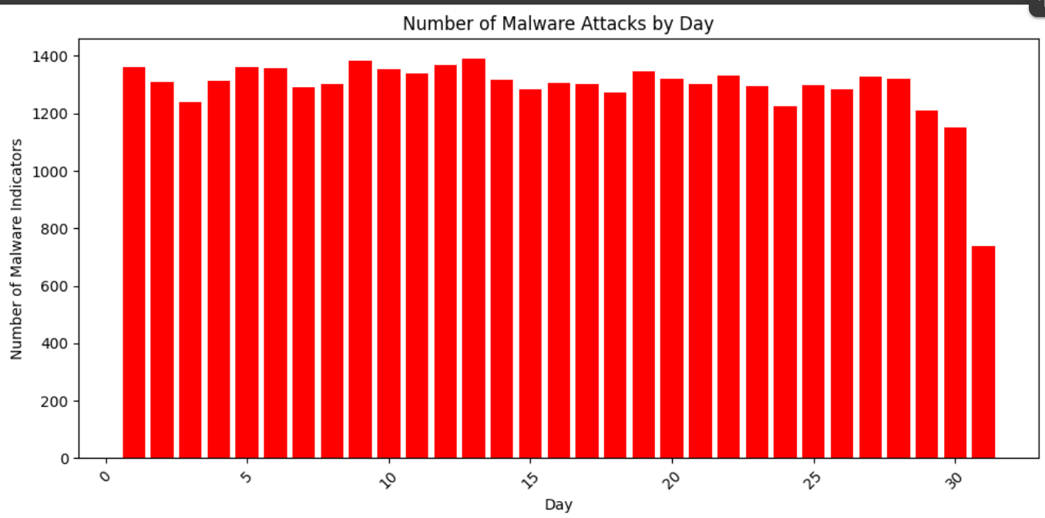
CODE AND CONCLUSION:-
CONCLUSION :- The chart shows how malware attacks aren't spread out evenly across the week. Some days clearly see more suspicious activity than others. This kind of pattern can be really useful it helps us understand when systems might be most at risk. If we know which days tend to have more attacks, we can be better prepared, tighten security on those days, and stay a step ahead of potential threats. In short, spotting these trends helps us protect our systems more effectively and plan smarter.

Slide 19
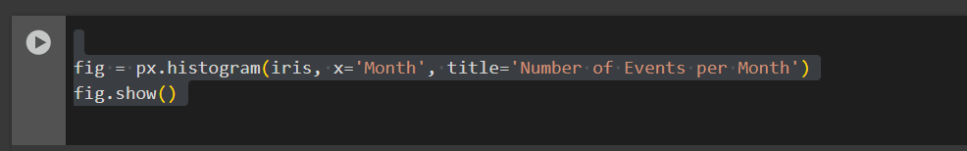
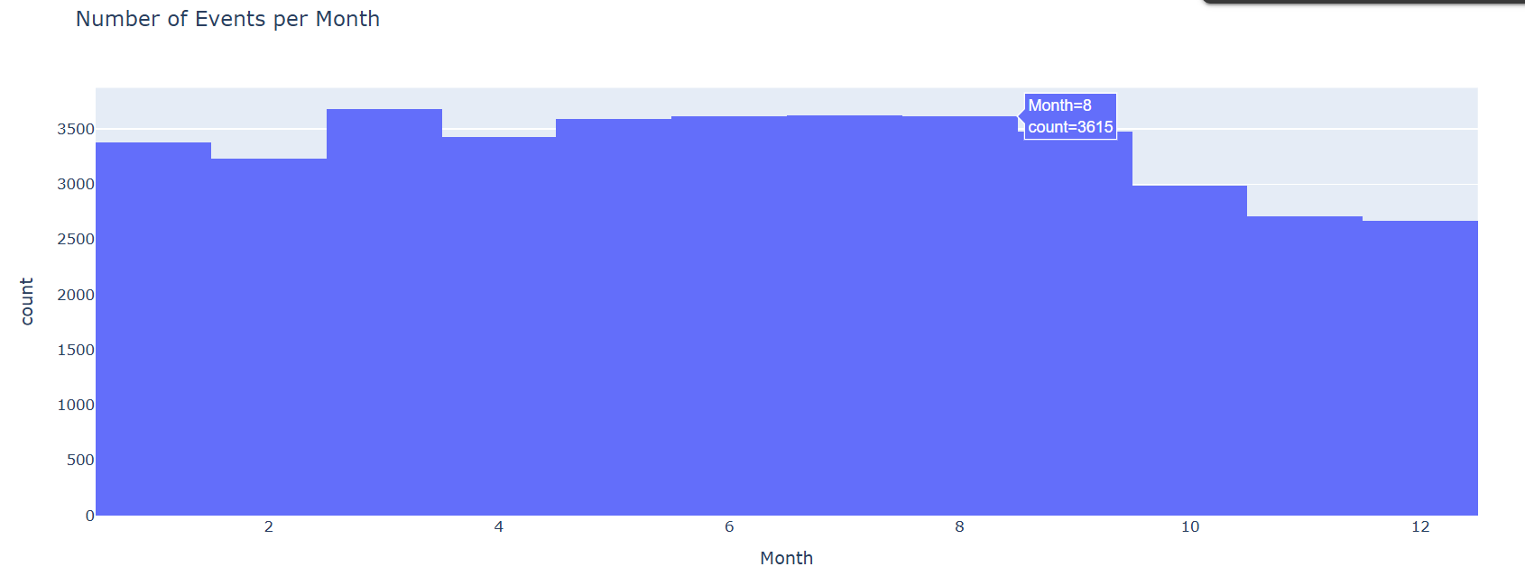
CODE AND CONCLUSION:-
Conclusion:-The histogram shows how events are distributed across each month. We can clearly see that some months experience a higher number of events compared to others. This pattern can help us understand when activity peaks, allowing teams to better prepare and allocate resources. By keeping an eye on these trends, it's easier to stay proactive and ready for busier times during the year.

Slide 20
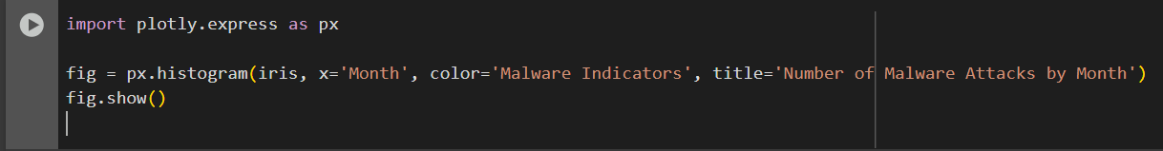
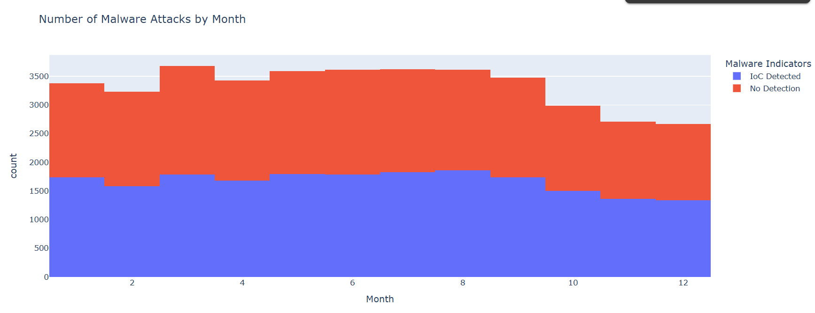
CODE AND CONCLUSION:-
CONCLUSION :- This chart shows how many malware attacks happened each month. Some months had more attacks than others. The colors show different types of malware. This helps us know which months are more dangerous, so we can be more careful and protect our systems better.

Slide 21
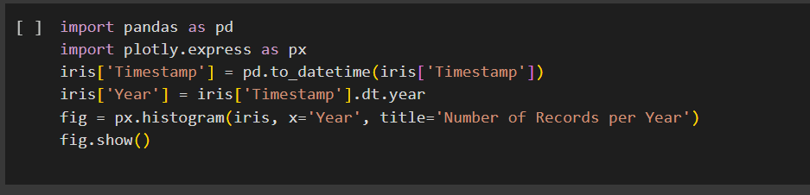
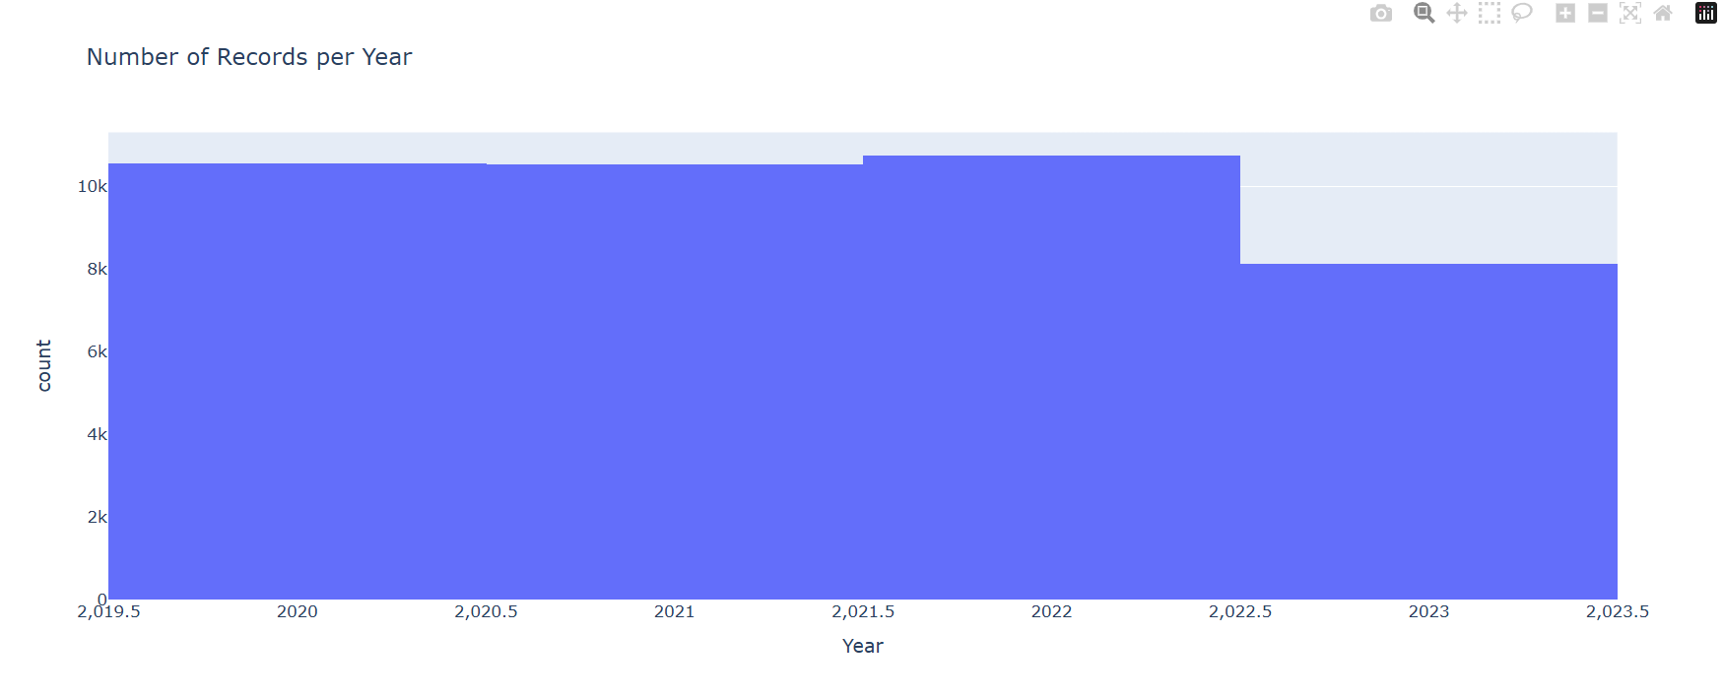
CODE AND CONCLUSION:-
CONCLUSION:- This chart shows how many records were collected each year. Some years had more records than others. This helps us see which years had more activity or data. It’s useful for understanding when most of the events happened.

Slide 22
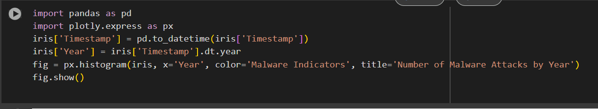
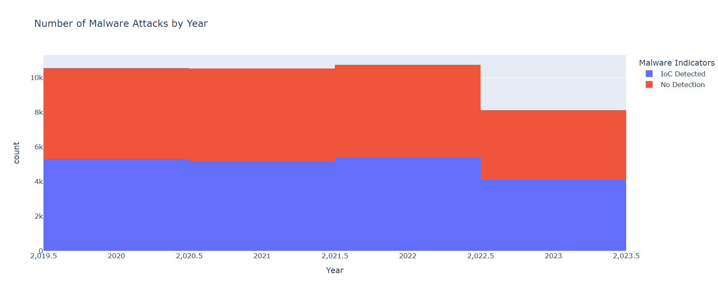
CODE AND CONCLUSION:-
CONCLUSION:- This chart shows how many malware attacks happened each year. The colors show different types of malware. Some years had more attacks than others. This helps us understand which years were more dangerous and what kinds of malware were active. It can help us prepare better for the future.

Slide 23
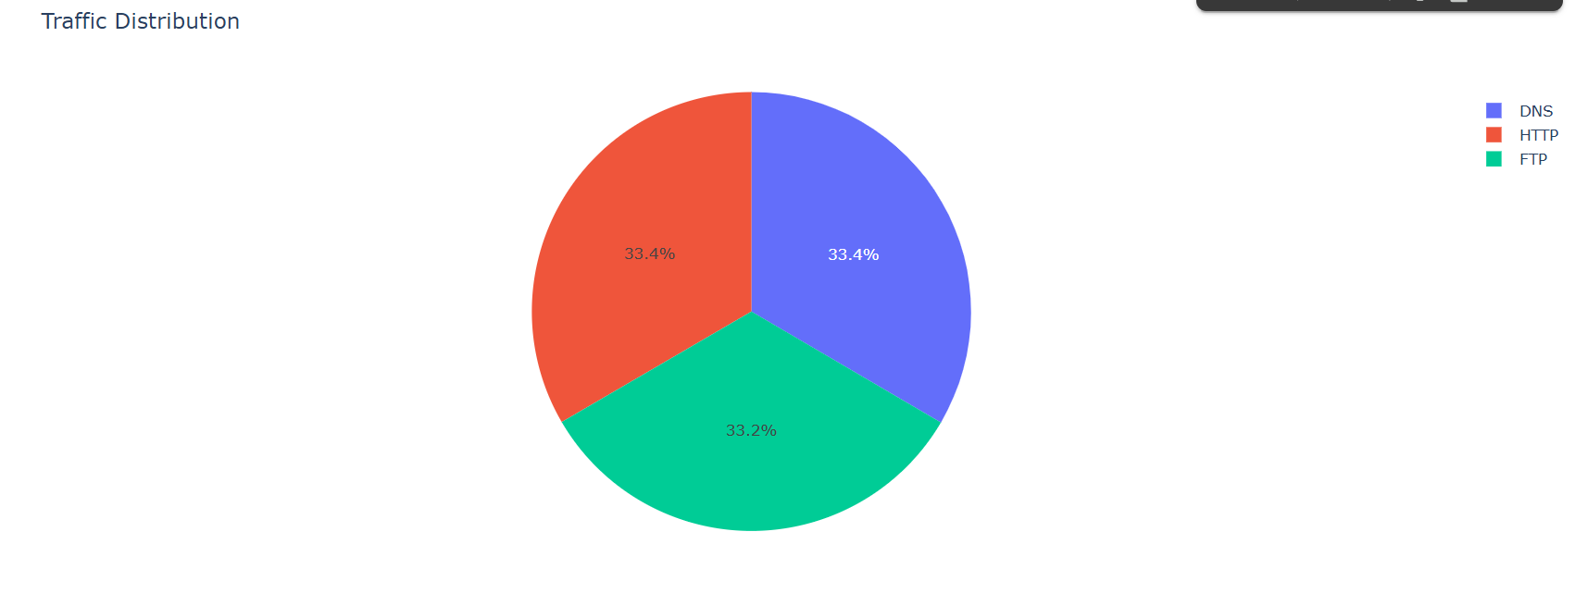
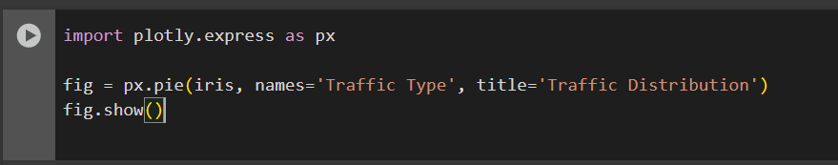
CODE AND CONCLUSION:-
CONCLUSION:- This chart shows how different types of network traffic are divided. Some traffic types are used more than others. By looking at this, we can understand which type of traffic is most common and where we should focus our attention to keep the network safe.

Slide 24
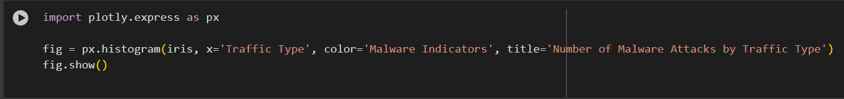
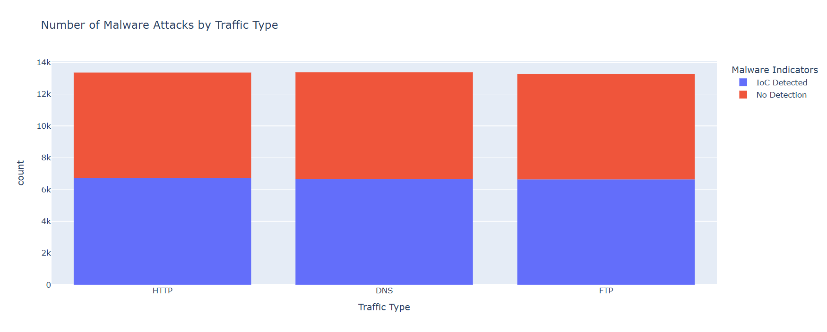
CODE AND CONCLUSION:-
CONCLUSION:-
This chart shows which types of network traffic have more malware attacks. Some traffic types have more attacks than others. The colors show different types of malware. This helps us know which traffic types are more risky and need more security.

Slide 25
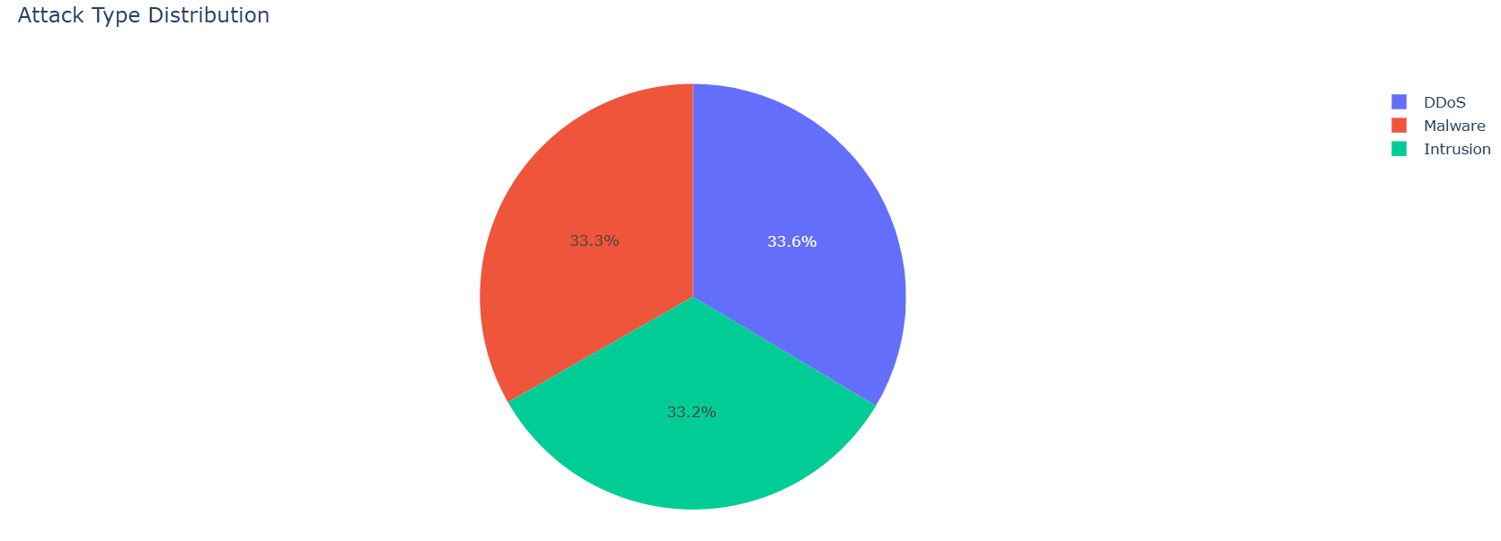
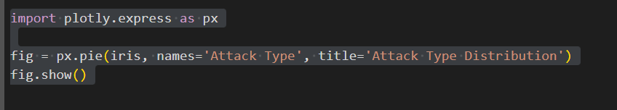
CODE AND CONCLUSION:-
CONCLUSION:-This chart shows the different types of attacks and how often each one happens. Some attacks are more common than others. This helps us know which attack types we should watch out for the most.

Slide 26
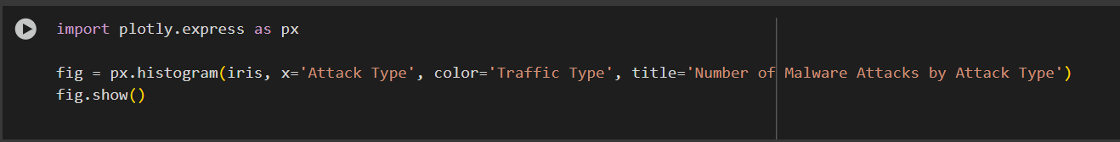
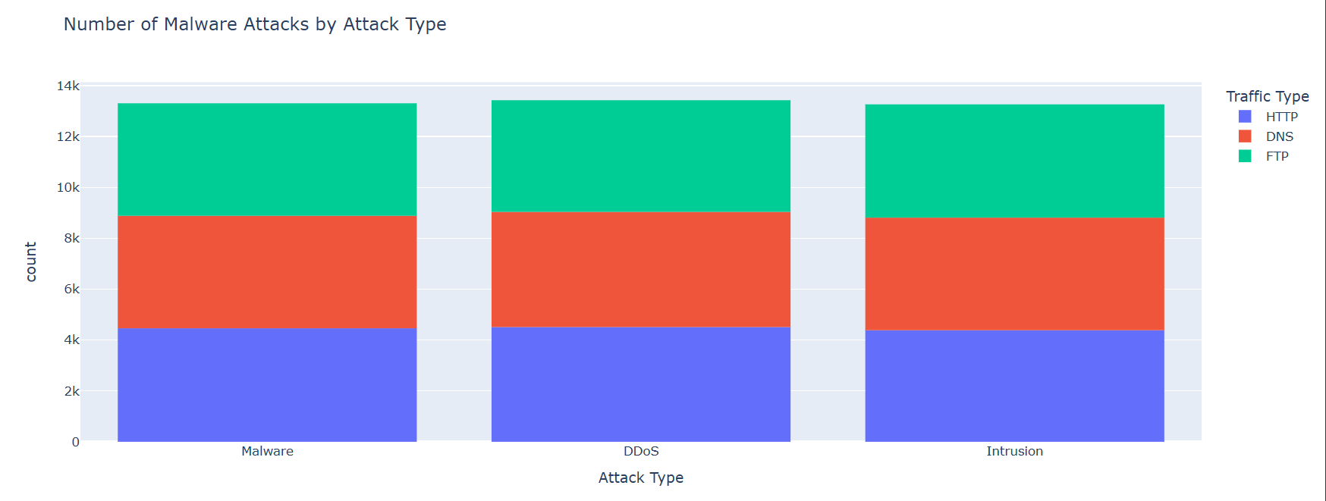
CODE AND CONCLUSION:-
CONCLUSION:- This chart shows how many malware attacks happened for each type of attack. The colors show which traffic type was used. Some attack types are more common than others. This helps us understand which attacks happen the most and how they are spread through different traffic types. It can help us improve our network security.

Slide 27
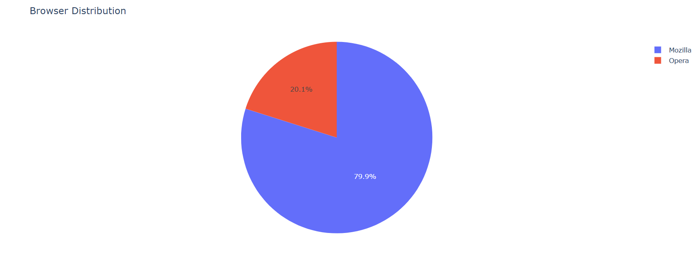
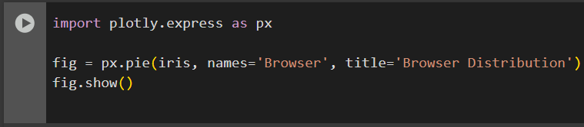
CODE AND CONCLUSION:-
CONCLUSION:-This chart shows which web browsers people are using. Some browsers are used more than others. This helps us understand which browsers are most popular, so we can focus on supporting and securing them better.

Slide 28
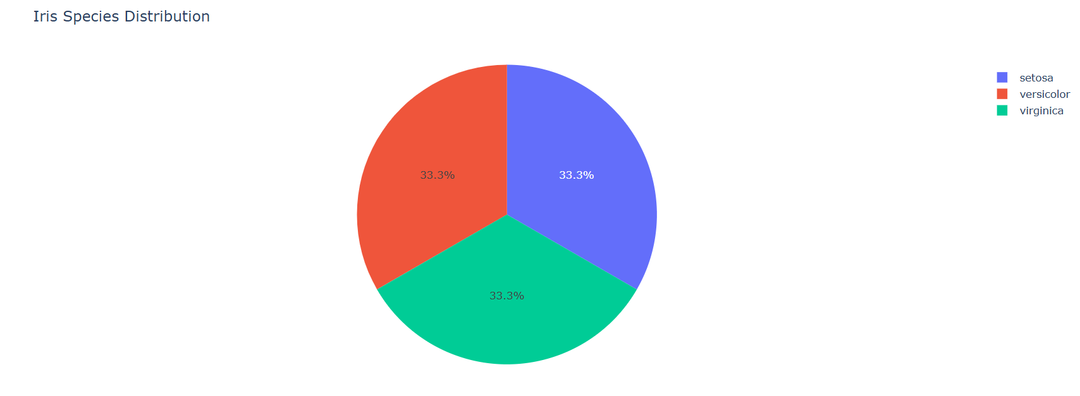
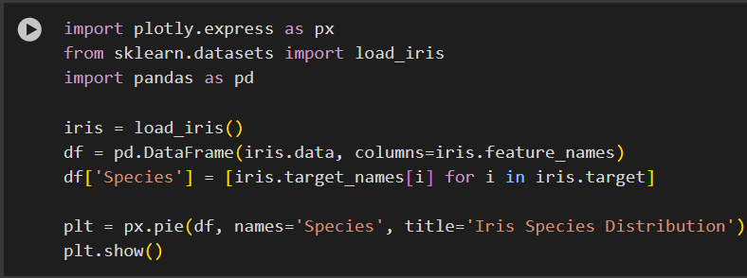
CODE AND CONCLUSION:-
CONCLUSION:- This chart shows the number of flowers from each iris species in the dataset. All three species are included. It helps us see if the data is balanced or if one species appears more than the others. This is useful for understanding the dataset before doing any analysis or machine learning.

Slide 29
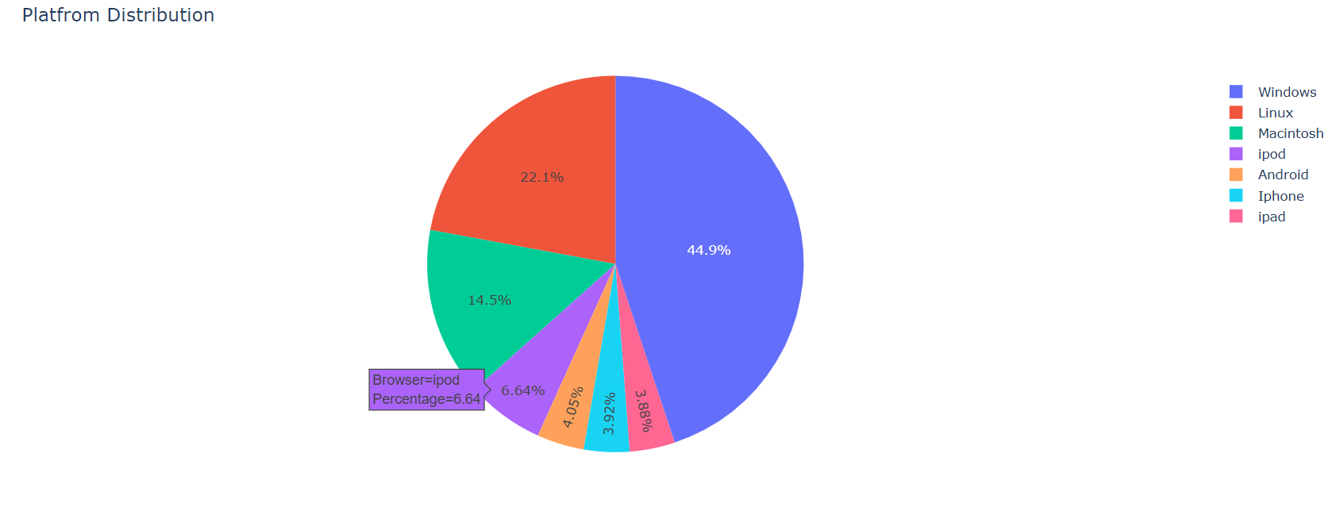
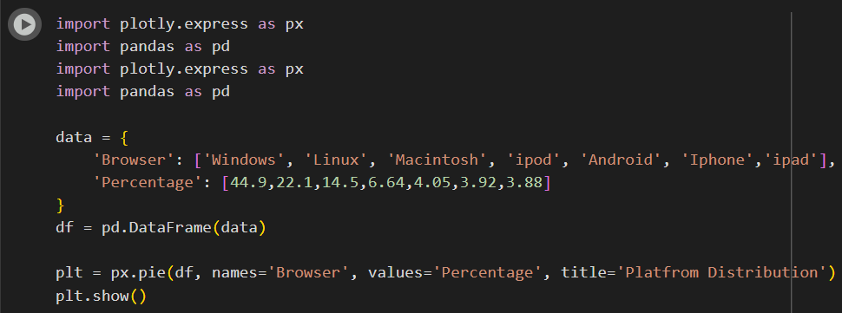
CODE AND CONCLUSION:-
CONCLUSION:- This chart shows which platforms people are using the most. Windows is used by the most people, followed by Linux and Macintosh. Smaller numbers use iPods, Android, iPhones, and iPads. This helps us understand which platforms are most common, so we can focus on supporting or securing those first.

Slide 30
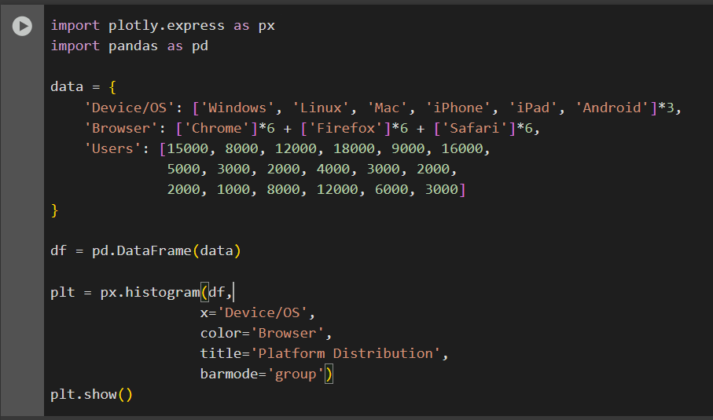
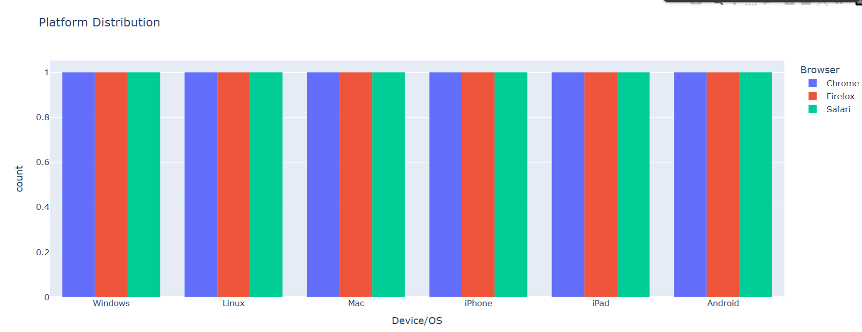
CODE AND CONCLUSION:-
CONCLUSION:- This chart shows how many users use each device or operating system with different browsers. We can see that some browsers, like Chrome, are more popular on certain devices. For example, Chrome has many users on Windows and Android, while Safari is mostly used on Apple devices like iPhone, iPad, and Mac. This helps us understand which browser and platform combinations are most common, so we can focus on them when designing or securing applications.

Slide 31
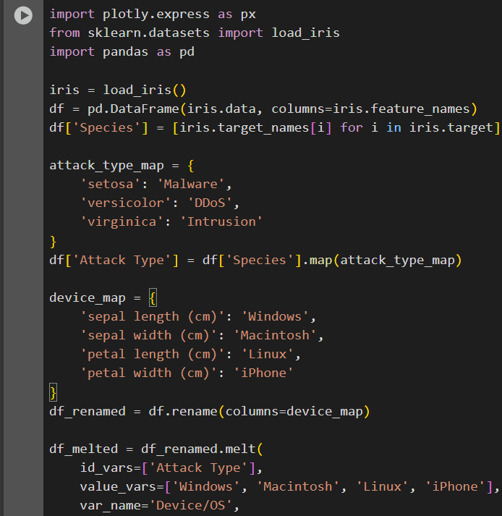
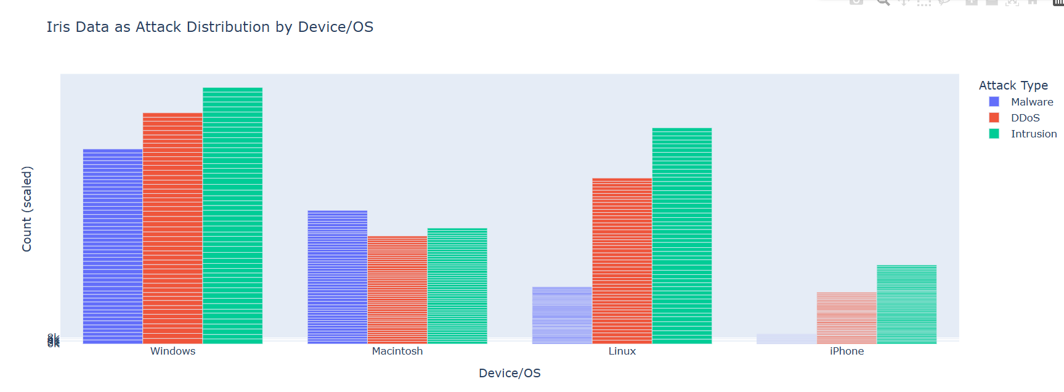
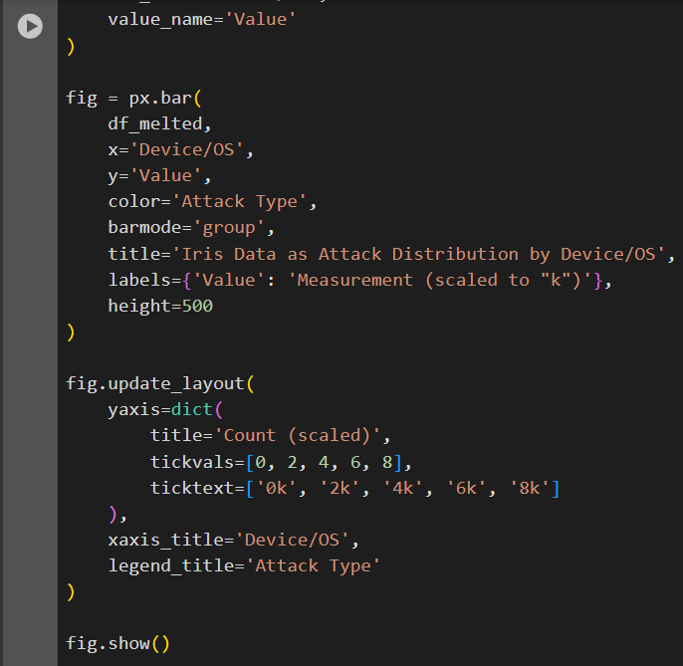
CODE AND CONCLUSION:-
CONCLUSION:- This chart shows how different types of attacks (Malware, DDoS, Intrusion) are spread across different devices like Windows, Mac, Linux, and iPhone. Each colored bar tells us how much activity was seen for each attack type on each device. From this, we can easily see which devices face more risk from certain attacks. This helps us know where to focus more on improving security.

Slide 32
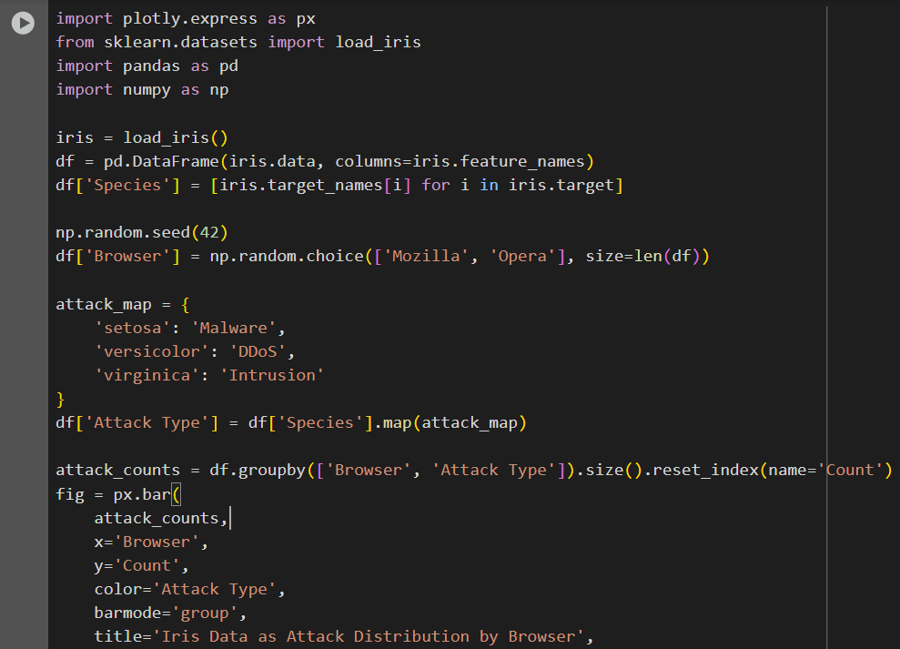
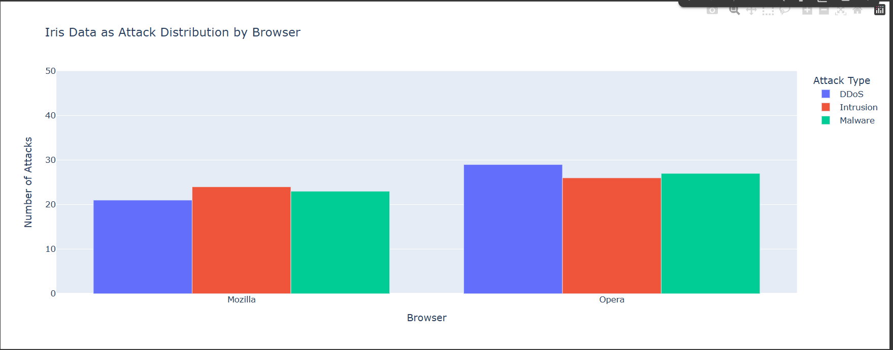

CODE AND CONCLUSION:-
CONCLUSION:- This chart shows how many attacks (Malware, DDoS, Intrusion) were found in each browser Mozilla and Opera. The different colors show different types of attacks. From the chart, we can see which browser had more of each type of attack. This helps us know which browser might need more protection from certain cyber threats.

Slide 33



CODE AND CONCLUSION:-
CONCLUSION:- This chart shows how many events came from different log sources: Server, Firewall, and Log Source. Most events came from the Server, followed by the Firewall, and then the Log Source. This helps us understand which system is generating the most activity and where we should focus our monitoring and security efforts.

Slide 34



CODE AND CONCLUSION:-
CONCLUSION:-This chart shows what security actions were taken Logged, Blocked, or Ignored and how many times each action happened. Most actions were either Logged or Blocked, while Ignored was less common. This helps us understand how often the system responds to different events and which actions are taken more seriously.

Slide 35




CODE AND CONCLUSION:-
CONCLUSION:- This chart shows how many security events were Logged, Blocked, or Ignored for each attack type Malware, DDoS, and Intrusion. The bars help us see which actions are taken more often for different types of attacks. For example, some attacks are mostly blocked, while others might just be logged or ignored. This gives us a clear idea of how the system reacts to different cyber threats.

Slide 36




CODE AND CONCLUSION:-
CONCLUSION:-This chart shows how many attack events (like Malware, DDoS, and Intrusion) came from different log sources: Server, Firewall, and general Log Source. Most of the attack data came from Servers, followed by Firewalls. We can also see that Malware attacks are the most common, especially from the Server log source. This helps us understand where most attacks are being detected and what types of threats are happening more often.

Slide 37




CODE AND CONCLUSION:-
CONCLUSION :- This graph shows the distribution of packet lengths for different types of cyber attacks: Malware, DDoS, and Intrusion. Each color represents a different attack type:-
1. Malware packets are mostly shorter in length
2.DDoS and Intrusion packets have a wider range of lengths.
3.Most packet lengths fall between 500 and 1500 bytes.
This helps us understand how different attacks behave based on the size of the data packets they use.

Slide 38


